Slide 1
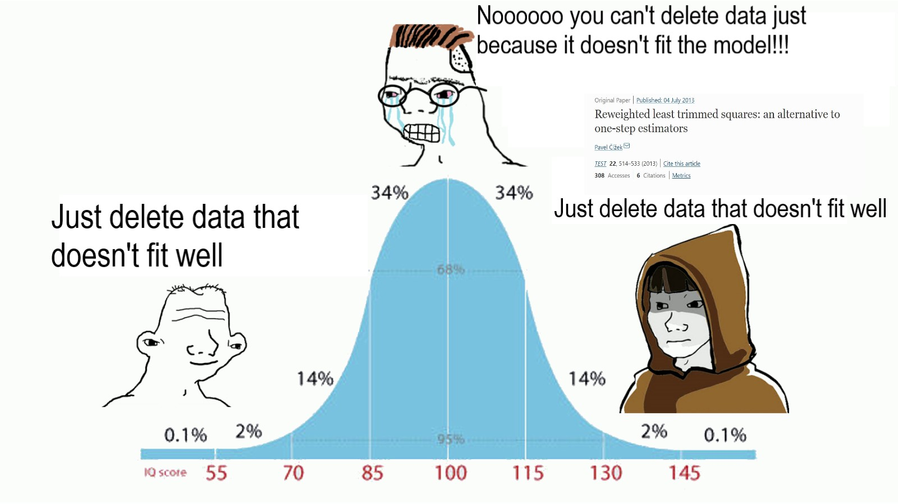
Fun with Residuals

Slide 2
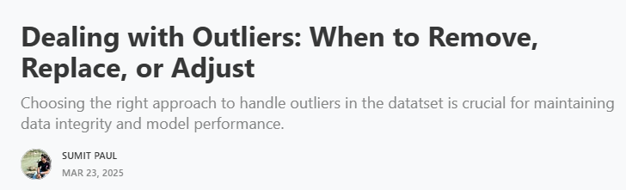


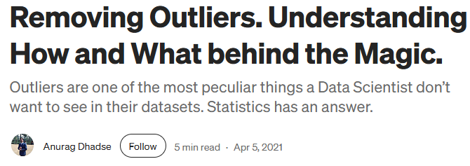
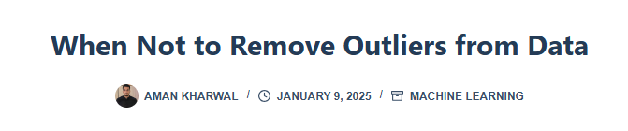
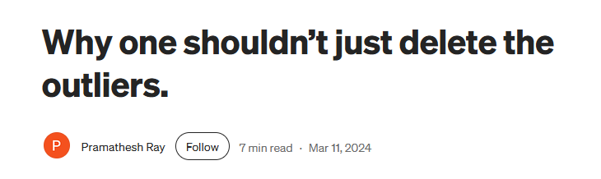

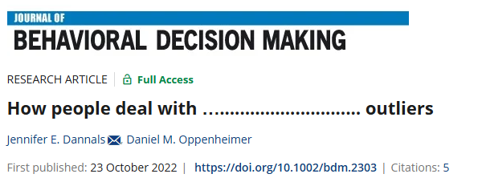

Data Outliers: A divisive topic among statisticians

Slide 3
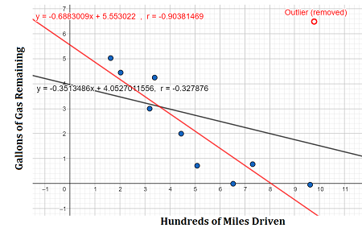
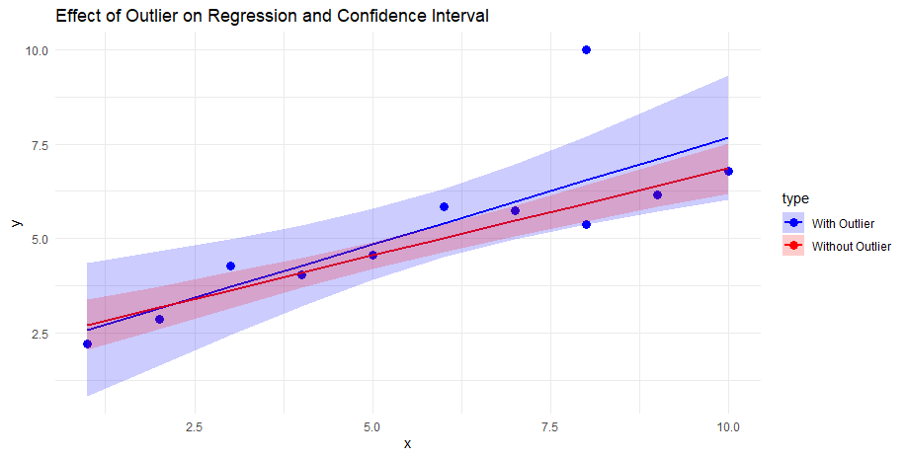
How do outliers effect statistical models?
Shifts coefficients/inflates or deflates effects
Increase variance and Standard Errors
Outliers inflate residual variance, which increase SE of the coefficients
Larger SE -> smaller test statistics (t) -> larger p-values
Outliers make coefficients less precise.
Violate model assumptions
Normality of residuals
Homoscedasticity

Slide 4
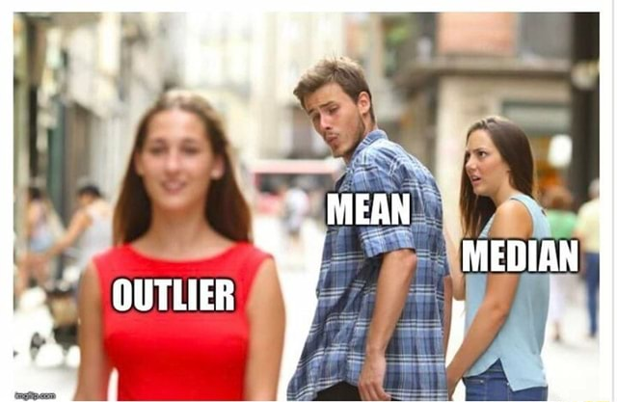
What are residuals?
The difference between an observed value and a predicted values
It is calculated as:
Residual = Observed value – predicted value
Recall that the goal of linear regression is to quantify the relationship between one or more predictor variables and a response variable
To accomplish this, linear regression finds the line that best “fits” the data
“Least squares regression line”

Slide 5
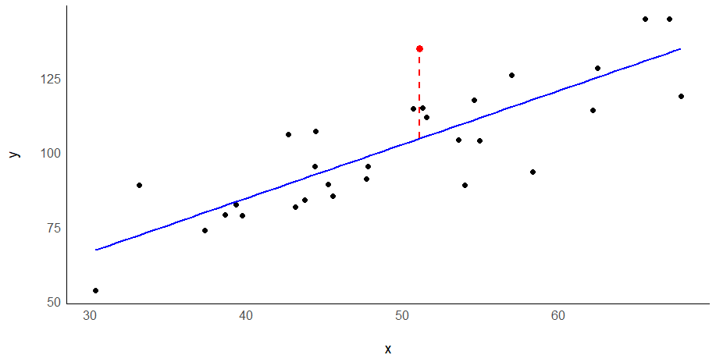





Single Level Model with One Predictor
Level 1
Ordinary Least Squares regression aims to decrease the variance of the residuals
$$Y_{i}= β_{0} + β_{1}{Time}_{i}+ e_{i}$$
Fixed Intercept
Fixed Slope
Residuals
$$e_{14}$$
$$=30.18$$
We can calculate residuals by using algebra
$$134.75=12.63+1.80(51.11)+ e_{14}$$
$$134.75=104.57+ e_{14}$$
$$30.18=e_{14}$$

Slide 6
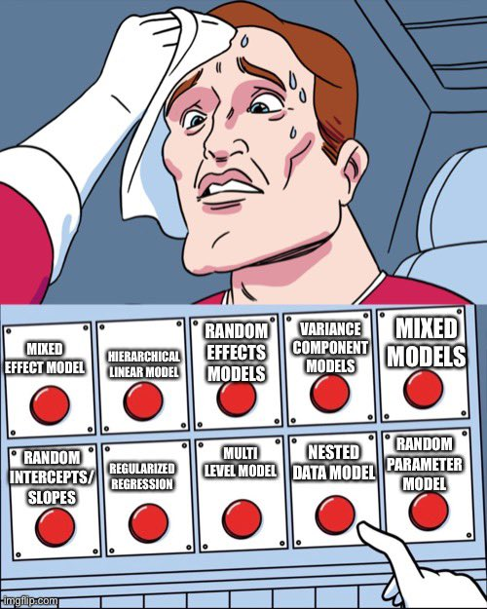



Level 1
$$Y_{t,i}= β_{0} + β_{1}{Time}_{t,i}+ e_{t,i}$$
Residuals
$$β_{0}= γ_{00}+ u_{0i}$$
Level 2
Fixed Intercept
Random Intercept
$$β_{1}= γ_{01}$$
Fixed Slope
Combined
$$Y_{t,i}=γ_{00}+γ_{01}{Time}_{t,i}+u_{0i}+e_{t,i}$$
Fixed Stuff
Random Stuff

Slide 7
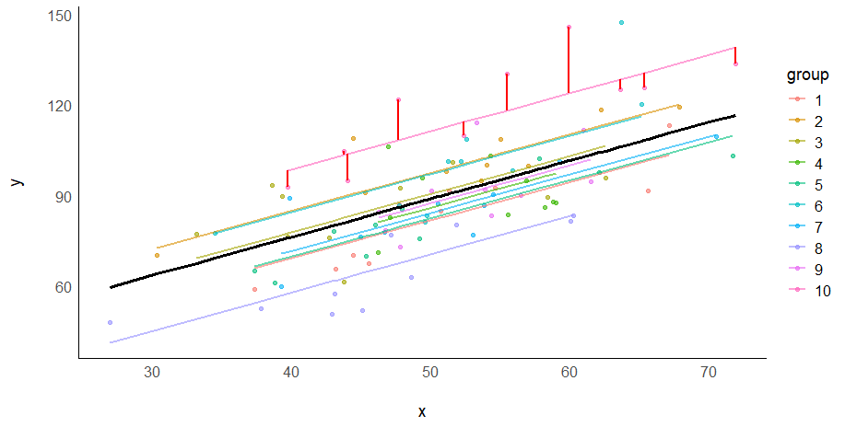

$$Y_{t,i}=γ_{00}+γ_{01}{Age}_{t,i}+u_{0i}+e_{t,i}$$
Level 1 Residuals
Level 2 Residuals
(i.e., random intercepts)

Slide 8




Calculating multilevel residuals is a little more complex and involves shrinkage
Shrinkage factor
“Raw” residuals
$${\hat{u}}_{0i}=\frac{σ_{i}^{2}}{σ_{i}^{2}+ \frac{σ_{t,i}^{2}}{n_{t,i}}}∗r_{i}$$
Level 2 residual
$$r_{t,i}=y_{t,i}−{\hat{y}}_{t,i}$$
where
$$r_{i}$$
is the mean of
$$r_{t,i}$$
For person i
Level 1 residual is the observed value, minus the predicted value from the overall regression line, minus the level 2 residual
$${\hat{e}}_{t,i}=y_{t,i}−γ_{01}\left({\hat{β}}_{0} + {\hat{β}}_{1}{Age}_{t,i}\right)−{\hat{u}}_{0i}$$

Slide 9
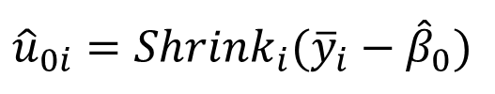
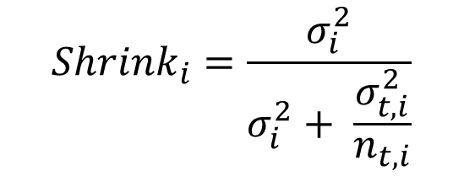


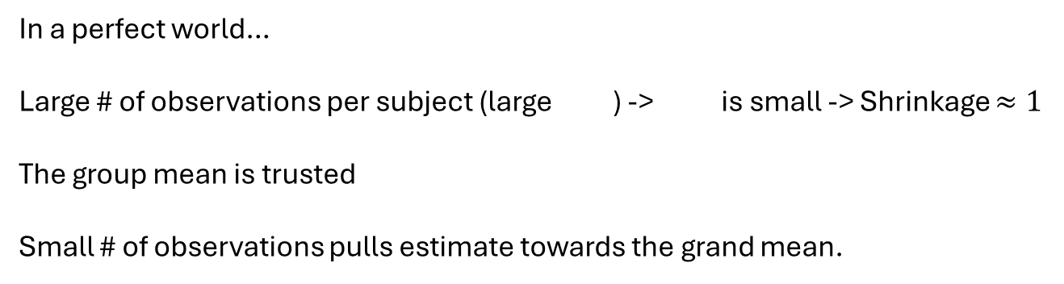
I didn’t want to get into shrinkage factor…
Between-person variance
Within-person variance
Number of observations per person
$${Shrink}_{i}=\frac{σ_{i}^{2}}{σ_{i}^{2}+ \frac{σ_{t,i}^{2}}{n_{t,i}}}$$
In a perfect world…
Large # of observations per subject (large ) -> is small -> Shrinkage $≈1$
The group mean is trusted
Small # of observations pulls estimate towards the grand mean.
$$\frac{σ_{t,i}^{2}}{n_{t,i}}$$
$${\hat{u}}_{0i}={Shrink}_{i}({\overline{y}}_{i}−{\hat{β}}_{0})$$
$$n_{t,i}$$

Slide 10
Short Answer
It really just depends on the goal of the analysis/model, the properties of the data, and the field of study.
Refer to similar papers and see what they do (or don’t do in some cases).
Visualize your data in many ways
Raw data plots
Residual vs fitted plot
QQ of residuals
Residual-based methods (today)
Keep in mind that not all outliers are “bad”, some might represent extreme cases.

Slide 11


Level 1
$$Y_{t,i}= β_{0} + β_{1}{Age}_{t,i}+ e_{t,i}$$
Residuals
$$β_{0}= γ_{00}+ u_{0i}$$
Level 2
Fixed Intercept
Random Intercept
$$β_{1}= γ_{01}+ u_{1i}$$
Fixed Slope
Random Slope
Combined
$$Y_{t,i}=γ_{00}+γ_{01}{Age}_{t,i}+u_{0i}+u_{1i}({Age}_{t,i})+e_{t,i}$$
Fixed Stuff
Random Stuff

